Slide 1
BCOG 100
Social Cognition
Lecture 3: Primate Brains

Slide 2
Reading Check 10-3
Password: pfc
Question: In the context of this week’s topic, what is a a false belief task, and how do scientists use it?

Slide 3
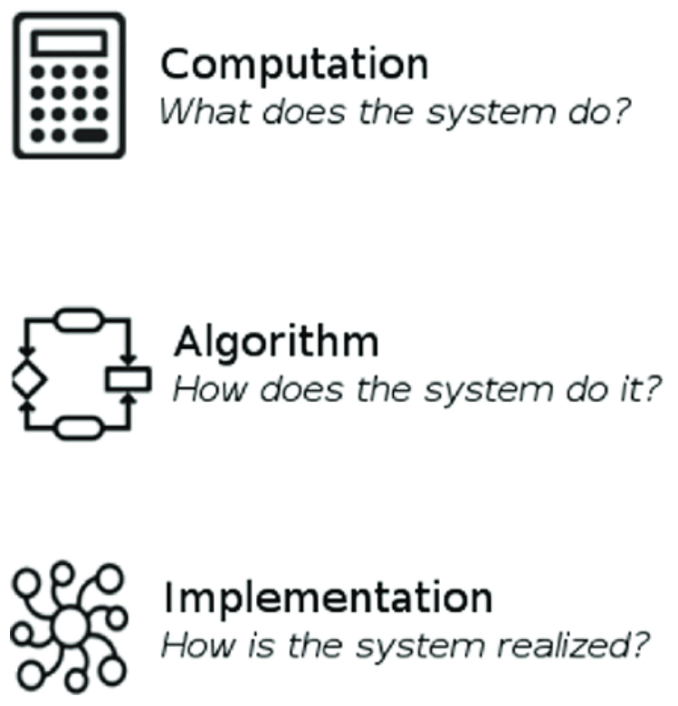
Primate Brains
Recap & Overview
Last Time:
Last time we identified three capacities underlying new primate behaviors: 1) modeling other minds, 2) modeling their own minds, 3) observational and learning
Today:
Today we ask what internal capacities made them possible
Notes:
In Lecture 1, we traced how primate social life introduced behavioral demands
that went far beyond what most mammals face:
navigating alliances, anticipating the future, tracking debts and favors, and learning from others.
In Lecture 2, we reframed those behaviors as computational challenges explainable in terms of
taking mammals simulation abilities and turning them on other primates and on their own minds.
This requires forming internal models of agents, futures, and action consequences.
The question now is: how did nervous systems actually implement these capacities?
Today we turn from what computations were needed to how the primate brain achieved them.
We are no longer explaining cooperation or imitation in abstract terms
— we are asking what neural machinery made them possible.
This is the shift from Marr’s computational and algorithmic levels to the implementational level,
where circuits, cell types, and development matter.
Our focus will stay primate-centered. Many mammals learn, plan, and recognize social partners,
but primates expanded the machinery needed to sustain rich internal models.
The goal today is not to memorize areas, but to see how biological changes made the computational story feasible.
By the end of this lecture, we should be able to connect a behavioral phenomenon
— like long-term alliance maintenance — to the computations it required,
and finally to the neural circuits that evolved to support it.

Slide 4
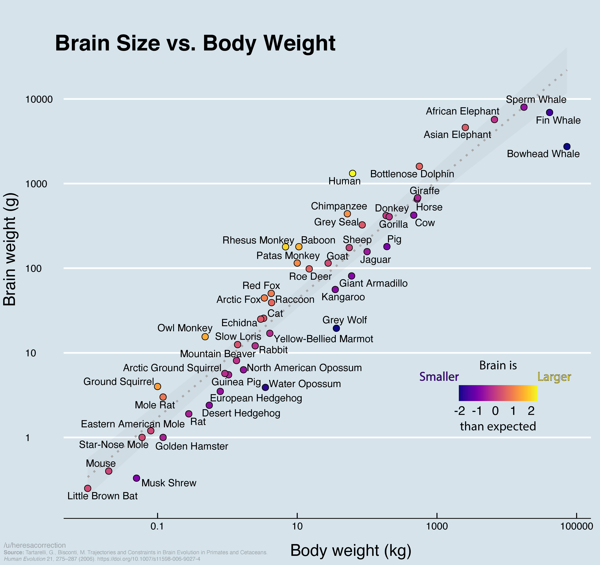
Primate Brains
Primate Brains Were Much Bigger
Primate brains expanded greatly
High brain-to-body ratio
Size matters — but isn’t the whole story
Notes:
Before we talk about how primate brains changed, we should briefly acknowledge a simple fact:
primate brains got dramatically larger over evolution.
Humans are the extreme case, but the pattern began much earlier
— early primates already had unusually large brains relative to body size
compared to most mammals.
This enlargement created a biological foundation for more neural connections,
more association areas, and more long-distance communication.
Across vertebrates, brain size relative to body size varies widely.
Fish and reptiles typically have much smaller brain-to-body ratios,
focusing resources on fast sensory-motor loops and instinctive behavior.
Birds and primates stand out with large, densely interconnected brains
— convergent strategies for supporting flexible behavior and learning.
Even within mammals, primates diverged sharply.
A macaque brain is more than four times the expected size for a mammal of its weight,
and a chimpanzee brain is roughly three times larger than a similarly sized monkey.
Human brains then extend that trend further, with especially dramatic expansion of association cortex.
But it’s important to be clear: size set the stage, but size alone is not the explanation.
Big brains created opportunity — what matters is how primates used the extra neurons,
how they rewired circuits for prediction and simulation,
and how development shaped these capacities across long childhoods.
So yes — brain enlargement was real and foundational,
but our goal today is to understand the architectural,
not just volumetric, story.

Slide 5
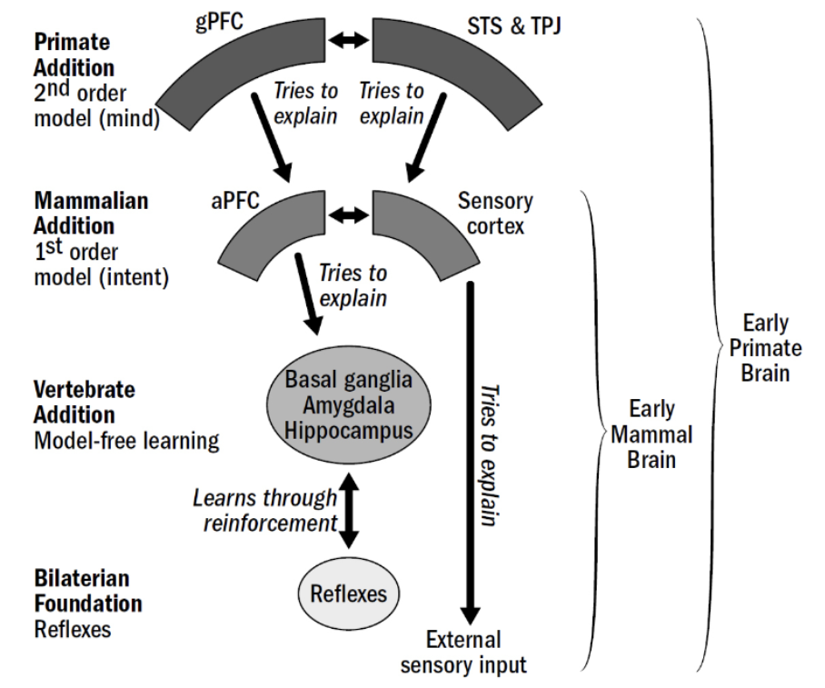
Primate Brains
Primate Brains Were Not Just Bigger
Not only size
New cortex, new wiring
New principles of control
Notes:
A common simplification is that primates just “got bigger brains,”
but what mattered most was not size alone
— it was what those extra neurons were doing and where they were placed.
Primates expanded association cortex disproportionately,
along with the white-matter tracts that connect distant regions into persistent, recurrent loops.
These expansions made it possible to maintain internal representations when no sensory input was present.
The primate brain did not replace older motivational and emotional systems;
it layered new circuitry on top of them.
This allowed ancient drives around survival and reproduction to be shaped by learned expectations,
evaluations of others, and long-term goals.
Flexible social behavior did not emerge from raw computational power,
but from a re-organization of control systems.
This layered design is crucial:
primate cognition reflects a dialogue between ancient limbic circuits
and newer regulatory systems in prefrontal and temporal cortex.
The story today is about how this expanded neural workspace
allowed primates to behave toward imagined futures
and inferred social states rather than only reacting to the present.
This is what distinguishes a clever foraging mammal from a macaque weighing alliances years in advance.

Slide 6
Primate Brains
A Social Mind
Sustained Representations
Multimodal Integration
Flexible Routing/Gating
Recurrent Loops
Social Value Tagging
Long-term Memory Coordination
Internal models need:
Notes:
Now that we know what primates had to compute,
we can ask what kind of neural machinery would make that possible.
Before we look at regions, we’ll outline the design requirements implied by primate social cognition.
These are the architectural principles needed to simulate others,
simulate ourselves, and learn from observation.
First, primates needed sustained internal representations
— activity that persists even when nothing is happening externally.
Second, they needed multi-modal integration,
combining memory, perception, value, and action in a shared workspace.
Third, they needed gating and routing mechanisms
to protect goals, suppress distractions, and deploy behavior strategically.
They also required recurrent predictive loops,
where circuits could rehearse futures,
update expectations, and revise plans on the fly.
And because social life depends on reward, trust, and reputation,
primates needed a tight interface between value circuits and memory systems.
In short: the computational capacities we saw in Lecture 2 imply
a nervous system built for holding possibilities and choosing among them.
Keep these themes in mind — in the next slides we’ll see where in the brain they live,
how they developed, and what neural innovations made them possible.
This slide bridges our Marr levels: from the functions primates had to compute
to the physical architectures that compute them.

Slide 7
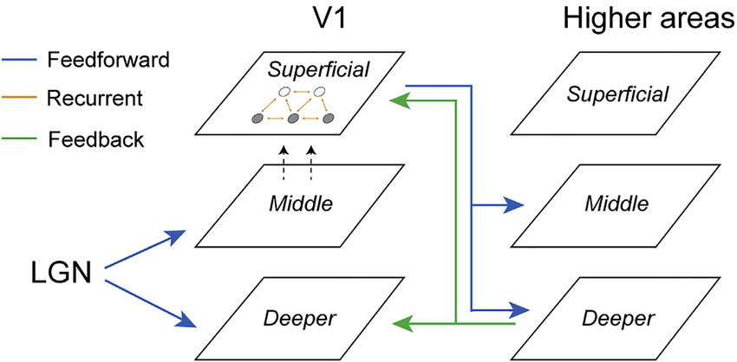
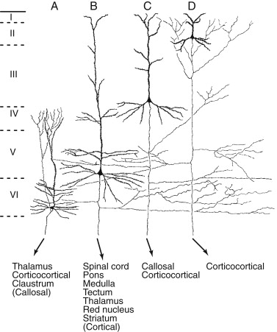
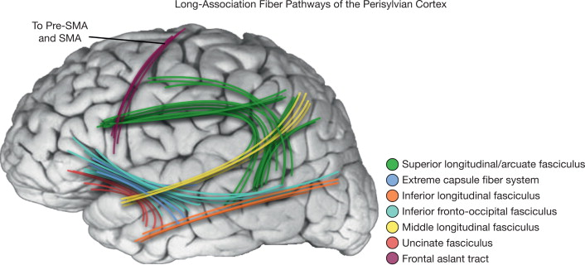
Primate Brains
White Matter and Recurrent Connectivity Expanded
Long-range pathways expanded
Recurrent loops strengthened
Persistent network dynamics
Notes:
Once internal models became behaviorally useful,
primates evolved the circuitry to sustain and distribute them across the brain.
A major part of this shift was the expansion of white matter,
the long-range axon bundles that connect distant cortical regions.
More white matter meant more bandwidth for information to travel,
allowing representations to be shared across memory, value, perception, and action systems.
In primates — unlike rodents — association areas show disproportionately enlarged long-range corticocortical axons,
especially fronto-temporal and fronto-parietal tracts.
For example, the superior longitudinal fasciculus and uncinate fasciculus
are dramatically more developed in primates and support communication between PFC,
temporal cortex, and limbic structures.
This wiring infrastructure enables circuits to hold and combine social memories, predictions, and goals.
At the same time, recurrent connectivity
— loops where signals feed back into earlier processing stages
— expanded and strengthened.
Recurrent loops allow activity to continue after a stimulus disappears,
giving internal models a life of their own.
Instead of responding only to current input, primate brains can maintain expected states
and update internal simulations in their absence.
For example, primates have expanded layer III pyramidal neuron networks
with long horizontal axon collaterals and dense reciprocal connections
across cortical columns and areas.
They also show hyper-developed cortico-cortical feedback projections f
rom higher-order association areas to earlier sensory regions
— a feature far less pronounced in non-primates.
These dense recurrent pathways allow primates
to sustain internally generated activity streams without external triggers.
These wiring changes supported a new operating mode:
persistent network dynamics that could hold “future-oriented” states in place.
This is how the brain becomes a system that keeps intentions active,
instead of one that resets when the world quiets down.
White-matter growth and recurrent circuitry did not replace older learning systems
— they layered new control onto them.
The result was a brain capable of running internal simulations,
keeping long-term plans active, and coordinating behavior toward them.
Next, we’ll see how these connectivity innovations converged in prefrontal and association cortex,
the central workspace for social strategy.

Slide 8
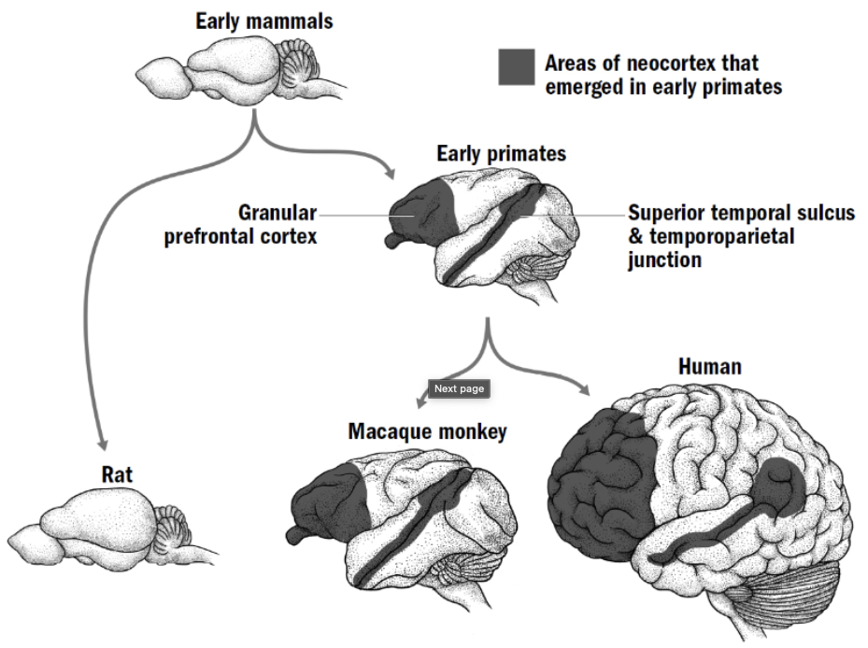
Primate Brains
Association Cortex + PFC Formed a Coordinated Workspace System
Expanded association cortex
PFC orchestrates use & routing
Shared workspace across systems
Notes:
Across primates, association cortex expanded more than any other functional territory,
especially in frontal and temporal lobes.
This expansion increased the amount of cortex devoted not to sensation or movement,
but to holding, combining, and transforming internal representations.
It created a substrate capable of storing multiple possibilities at once
— a requirement for simulating agents, futures, and contingencies.
Within this enlarged association cortex, prefrontal cortex (PFC) emerged as a specialized orchestrator.
Association areas can represent information; PFC determines what should be active,
what should be suppressed, when to switch, and how to route signals across systems.
In primates, this produced a coordinated workspace
in which memory, value, perception, and action systems
could be accessed and reconfigured flexibly.
Structurally, this integration depended on massively increased cortico-cortical projections,
especially between PFC, temporal cortex, and parietal association areas.
Primates also evolved more diverse pyramidal cell types and laminar specialization in these regions,
enabling finer control of recurrent loops and long-range signaling.
Rather than a single “thinking center,” primate cortex functions as a distributed workspace with a conductor.
Functionally, this architecture supports long-horizon behavior.
A chimpanzee deciding whether to help an ally in a fight must maintain social memories,
evaluate future payoffs, inhibit impulsive reactions, and coordinate motor readiness
— all while the world continues to unfold.
The primate workspace system provides the neural real estate and control mechanisms to do this.
From here, we turn to its components
— beginning with regions that specialize in rules, value, conflict, and strategic depth.

Slide 9
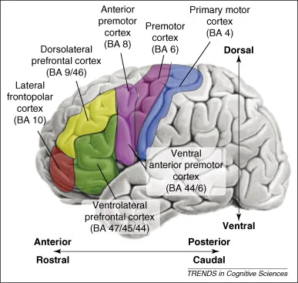
Primate Brains
DorsoLateral Prefrontal Cortex (DLPFC): Task Sets & Counterfactual Rules
Maintain task structure
Evaluate “if–then” rules
Support counterfactuals
Notes:
One core component of the primate prefrontal system is dorsolateral prefrontal cortex (DLPFC).
While association cortex can hold representations,
DLPFC maintains task structure, rules, and contingencies
— the “if–then” scaffolding needed for flexible behavior.
This includes the ability to hold multiple possible action plans, switch between them,
and inhibit irrelevant ones.
In primates, DLPFC supports counterfactual reasoning
— thinking about what would happen if a different choice were made.
This is directly relevant to social strategy: choosing whether to challenge a rival
or defer requires comparing imagined outcomes.
These functions go beyond simple reinforcement
and require structured internal models of options and their consequences.
Neurally, DLPFC contains dense recurrent microcircuits
and receives convergent inputs from parietal and temporal association areas.
It also sends top–down projections to sensory and motor regions,
letting internal rules shape attention and action selection.
In primates, these circuits are larger, more laminated, and more interconnected than in other mammals.
This architecture allows an individual to hold a social rule in mind
even when current stimuli are tempting or ambiguous.
A subordinate macaque, for example, may suppress a food grab when the dominant individual is nearby,
not due to fear alone, but because its internal model represents the likely outcome.
DLPFC underlies the capacity to act according to a plan rather than a moment,
a critical ingredient of social intelligence.
Next, we will examine regions that evaluate not rules but values and norms
— the other half of strategic control.

Slide 10
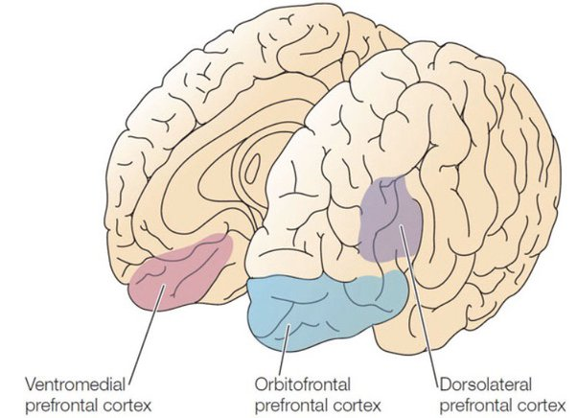
Primate Brains
VentroMedial PreFrontal Cortex (VMPFC) / OrbitoFrontal Cortex (OFC): Social Value & Norms
Evaluate outcomes & intentions
Track norms & social value
Flexible, context-dependent valuation
Notes:
If DLPFC helps primates hold rules and counterfactuals,
ventromedial prefrontal cortex (VMPFC) and orbitofrontal cortex (OFC)
help determine what those rules and choices are worth.
These regions assign value to actions, partners, and social strategies
— not just in terms of food or threat, but in terms of status, reputation, trust, and long-term benefit.
They integrate emotion, past experience, and expected outcomes into a single value landscape that guides choice.
In primates, OFC and VMPFC encode context-dependent value
— meaning the same action can be good in one setting and costly in another.
They track norms such as fairness expectations, reciprocity, tolerance, and coalition obligations,
updating value signals when norms are upheld or violated.
This is more than reward: it is social reward, shaped by expectations about others and by internalized group patterns.
Anatomically, these areas receive dense input from amygdala, hippocampus, temporal cortex, and sensory regions,
giving them access to signals about emotion, memory, identity, and current context.
They project heavily to striatum and hypothalamus, linking valuation to motivation and autonomic state,
and to PFC, where value-shaped decisions are implemented.
Compared to non-primates, primates show greater laminar differentiation and connectivity in these circuits,
supporting more flexible valuation.
This system lets a chimpanzee evaluate not just “what do I get now?”
but “what will this mean for my alliances, rank, and future support?”
It underlies behaviors like tolerating a partner’s temporary aggression
to preserve a long-term relationship or rejecting food when treated unfairly.
Together with DLPFC, OFC and VMPFC equip primates to make strategic choices
in a space shaped by social meaning, not just immediate payoff.
Next, we turn to a region specialized for detecting when behavior violates expectations or norms
— the anterior cingulate cortex.

Slide 11
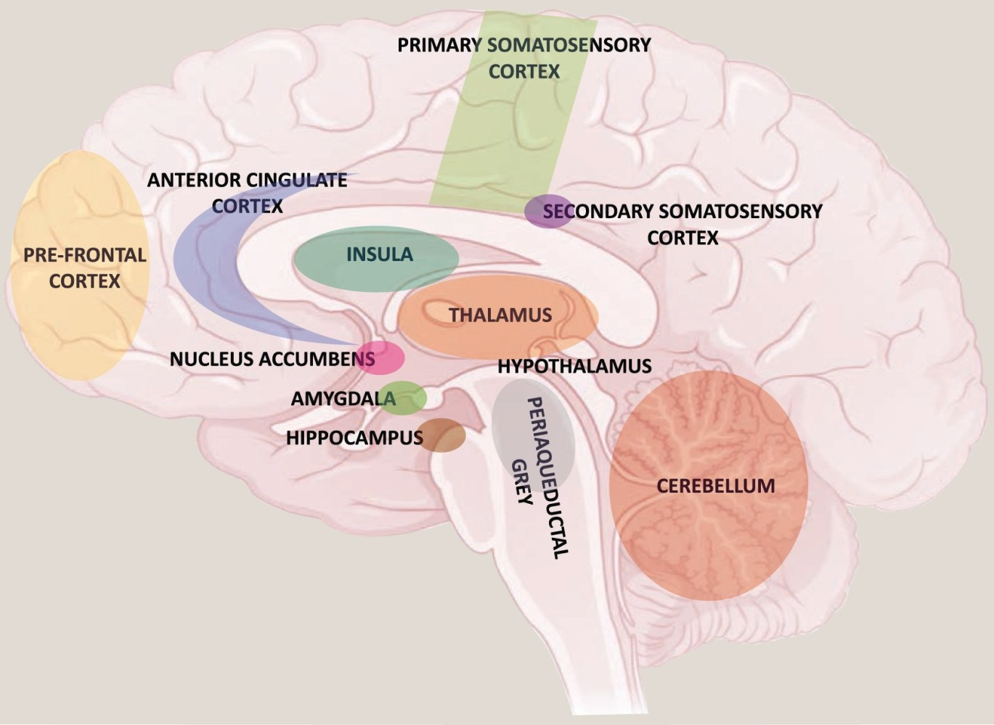
Primate Brains
Anterior Cingulate Cortex (ACC): Social Error & Conflict Monitoring
Detect conflict & social errors
Monitor outcomes vs expectations
Adjust behavior when stakes change
Notes:
The anterior cingulate cortex has long been involved in detecting
when the world does not match internal expectations.
In many mammals, that means recognizing when a movement goes wrong or a reward fails to appear.
What changes in primates is the domain of prediction:
the ACC now tracks social mismatches
— when alliances falter, norms are violated, or rank dynamics shift unexpectedly.
Rather than merely signaling “this outcome was worse than expected,”
primate ACC flags situations where the social world is deviating
from an internal model of how others should behave.
This includes moments when a grooming partner does not reciprocate,
a coalition member hesitates, or a higher-ranking individual behaves unpredictably.
The signal is not just about immediate cost; it reflects concern for future cooperation, trust, and reputation.
Neurally, the ACC sits where emotion, valuation, and executive control intersect.
It receives inputs from amygdala, basal ganglia, OFC/VMPFC, hippocampus, and sensory systems,
and sends outputs to frontal and motor areas,
allowing rapid adjustment when social reality shifts.
Compared to many other mammals,
primates show expanded ACC territories and stronger prefrontal connections,
reflecting the need to revise internal social models — not just motor plans — in real time.
Consider a macaque preparing to join an ally in a confrontation,
only to notice that a crucial partner has not arrived.
The ACC flags the inconsistency, weighs potential risk, and helps shift from aggression to caution.
This is not simply trial-and-error learning; it is strategic recalibration
based on the recognition that the social future has changed.

Slide 12
Primate Brains
Frontopolar / BA10: Nested Goals & Strategy
Track multiple future goals
Switch between plans
Strategic depth & abstraction
Notes:
At the very front of the primate prefrontal cortex lies frontopolar cortex (BA10)
— one of the most expanded regions in humans and greatly enlarged in apes
compared to other mammals.
This region supports the ability to hold multiple potential goals in mind,
evaluate them over long time horizons, and switch between them as contexts change.
It gives primates a capacity for strategic depth — pursuing one objective while keeping others in reserve.
BA10 helps manage nested goals: goals that are embedded inside other goals.
For instance, a chimpanzee may groom a lower-ranking individual today not for immediate benefit,
but to strengthen a chain of alliances that may later secure food access or support in conflict.
This requires holding an extended hierarchy of plans, rather than a single linear objective.
Neurally, BA10 in primates contains unusually complex neurons with more branches and connections,
allowing signals to be held and compared across time.
It also has especially rich communication loops with other prefrontal areas and temporal cortex, supporting the ability to juggle multiple ideas and return to them later.
It is especially tied to branching cognition
— the ability to suspend one task without abandoning it, explore an alternative, and then return.
Compared to non-primates, this territory is disproportionately enlarged,
suggesting that primate social life selected for planning beyond the current moment.
This system supports the ability to pause an action plan,
simulate outcomes, and resume if they remain favorable.
It also underlies the capacity to hedge strategies
— to court a potential ally while maintaining relations with another,
or to wait for a better opportunity rather than acting immediately.
With BA10, primates can hold alternative futures in active consideration,
a cognitive leap that made long-term coalition politics and deferred social investment possible.
Next, we shift from prefrontal specialization to the other cortical and subcortical systems
that collaborate with it in social cognition.

Slide 13
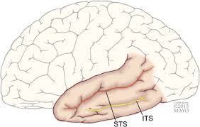
Primate Brains
Temporal Cortex / STS: Social Perception Hub
Recognize individuals
Read actions & expressions
Social meaning from perception
Notes:
Up to now, we’ve focused on prefrontal circuits that support planning and control.
But strategic social cognition also depends on
accurately perceiving other individuals in the first place.
For that, primates rely heavily on the temporal cortex,
especially the superior temporal sulcus, or STS.
The STS helps identify who is present and what they are doing
— reading faces, gaze direction, body posture, and vocalizations.
It allows primates to distinguish threat from play, interest from indifference,
and cooperation from competition.
In complex social groups, subtle cues carry meaning,
and STS extracts those signals quickly and with high sensitivity.
In primates, this region became specialized for detecting biologically relevant motion and facial cues,
and it connects richly to prefrontal circuits.
That means perceptual information can influence strategy in real time
— a quick glance toward food, a brief hesitation before approaching,
or a subtle shift in posture can all change the expected future.
Rather than merely seeing shapes and sounds, primates perceive agents with intentions in motion.
Finally, the STS supports long-term social memory as well,
helping individuals recognize familiar faces or calls and recall prior interactions.
It serves as a perceptual gateway into social cognition
— where sensation becomes information about who others are and what they might do next.
Importantly, although STS circuitry expanded in a world where reading others mattered for survival,
it is not “for” social cognition in a narrow sense.
The same architecture that evolved to process faces later supported other complex, learned categories
— for example, in many humans the most forward part of the STS region
recognizes written words on one side of the brain,
even though reading is far too recent to have shaped brain evolution.
This illustrates a key theme in cognitive evolution.
Circuits may originally have evolved for based on one adaptive constraint, like tracking social partners.
But once they exist, their newer computational capacities can be used for other purposes,
even becoming general-purpose pattern interpreters,
repurposed whenever culture created new symbolic demands.

Slide 14
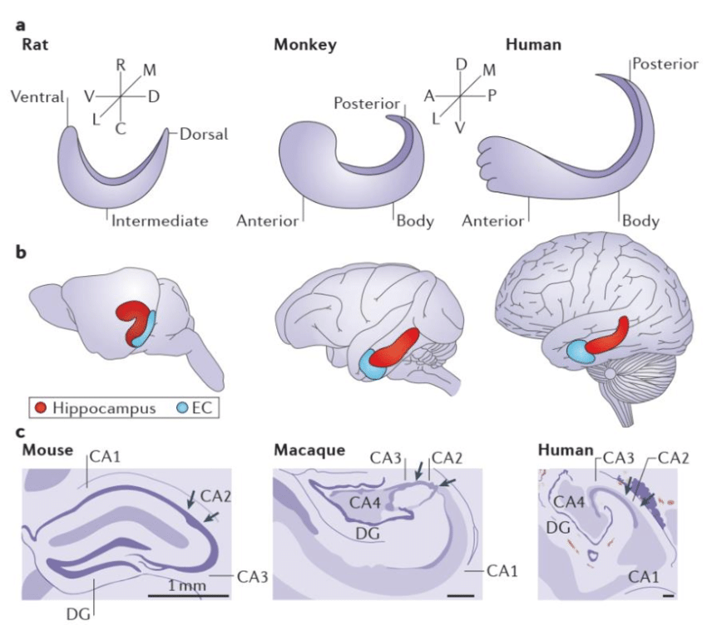
Primate Brains
Hippocampus & Social Memory
Previously: episodic memory & spatial maps
In primates: memory for relationships, alliances, betrayals
Integrates social history into future strategy
Notes:
By now we’re very familiar with the hippocampus
as the system that builds episodic memories and maps spaces
We’ve seen it in navigation, in reconstructive remembering, and in generative prediction.
So here we aren’t introducing a new mechanism,
but highlighting how primates repurpose this machinery for the demands of complex social life.
In primates, the hippocampus does not just track where food was or where a shelter is.
It also tracks who was where, who was with whom, and what happened in that interaction.
It binds people + place + time + context — not just events in the world, but events in the social world.
What’s distinctive in primates is not that the hippocampus stores memories, but which memories matter:
who supported you in a fight last month
who has groomed but never reciprocated
who rises in rank after a coalition shift
whose territory overlaps but remains peaceful versus threatening
This turns the hippocampus into a relational archive
— a storehouse of cooperation episodes, betrayals, reconciliations, courtships, and coalitions.
Neurally, primates show enhanced connectivity between hippocampus and prefrontal cortex, especially medial PFC.
That means episodes are not only stored — they’re evaluated, generalized, and used to simulate future interactions:
“If I groom her today, she’s likely to support me next week when tensions flare.”
So the hippocampus here is not a map of places, but a map of social possibilities.
It provides the memory substrate for long-term alliances and reputation
— key ingredients of primate social intelligence.

Slide 15
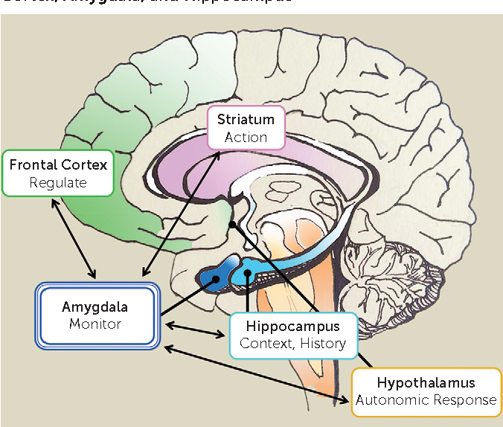
Primate Brains
Basal Ganglia & Amygdala: Motivation, Status, Emotion
Value learning for social life
Status tracking, threat detection, bonding
Primates: sensitivity to rank, reciprocity, reputation
Notes:
The striatum (basal ganglia) and amygdala are evolutionarily older structures
involved in motivation, learning, and emotion.
But in primates, these circuits take on distinctively social functions:
not just learning about food and threat, but learning about partners, rivals, allies, and status.
The striatum, which helps assign value to actions and outcomes,
becomes tuned not only to physical rewards, but to social rewards and penalties
— grooming, support, respect, exclusion, and status loss.
Neurons in primate striatum fire differently depending on who the individual is interacting with
and whether the partner is dominant, cooperative, or previously generous.
The amygdala, often thought of in terms of fear processing,
plays a broader role in tracking salience and relevance.
In primates, it encodes social threat, coalitional danger, and relationship importance.
Lesions here disrupt normal responses to rank and trustworthiness,
leading animals to make inappropriate approaches or fail to recognize dominance cues.
What’s particularly notable in primates is dense connectivity
between these subcortical circuits and prefrontal cortex.
That means value signals are contextualized, not reflexive.
It’s not simply “reward good,” but “reward from this partner, in this relationship, carries future significance.”
Emotion and reinforcement systems are therefore embedded
within strategic social cognition, not operating on instinct alone.
Together, these systems provide the motivational infrastructure
that makes hierarchy salient, loyalty rewarding, betrayal costly, and social investment worthwhile
— a value landscape tuned to navigating primate societies.

Slide 16
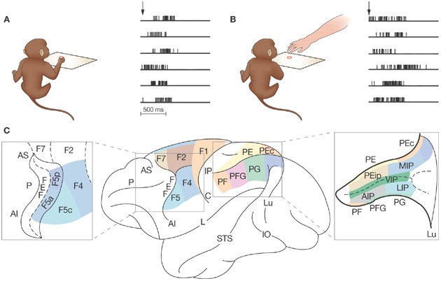
Primate Brains
Mirror-Adjacent Action Networks: Imitation Substrate
Value learning for social life
Status tracking, threat detection, bonding
Primates: sensitivity to rank, reciprocity, reputation
Notes:
Primates possess specialized circuits in premotor and parietal cortex
that link action perception to action execution.
These areas fire not only when performing actions,
but when observing others perform them
— a substrate that supports imitation, emulation, and learning from skillful models.
Critically, this system is not a generic “copy anything you see” mechanism.
In primates, these circuits are tuned to goal-directed actions and object interactions.
They represent not only the movement, but the intended outcome
— cracking a nut, retrieving a fruit, using a tool.
This is why primates often reproduce the goal rather than slavishly copying every motion.
Compared to rodents, where action circuits exist
but are more tightly tied to direct experience and reinforcement.
Primates exhibit stronger coupling between visual input, motor planning, and memory.
Neurons in macaque premotor cortex, for example, respond when seeing a conspecific grasp a food object, and similar cells fire when the monkey performs the grasp itself — a shared representational format for acting and observing.
This architecture enables selective social learning: watching experts, inferring intention, and adopting behaviors based on context, status, and expected payoff.
It forms a biological bridge between perception, action, and prediction, supporting the kinds of imitation and cultural transmission that set the stage for later human social learning and symbolic communication.

Slide 17
Primate Brains
Expanded Layer III & V Pyramidal Neurons
Value learning for social life
Status tracking, threat detection, bonding
Primates: sensitivity to rank, reciprocity, reputation
Notes:
One distinctive cellular feature of primate — and especially human — cortex
is the elaboration of layer III and layer V pyramidal neurons.
These are the principal cells that send and receive long-range cortical signals
and maintain sustained patterns of activity across time.
In primates, these neurons are larger, with longer dendrites, more branching,
and many more synapses than in non-primate mammals.
That means each neuron can integrate a far greater number of inputs,
weaving together spatial, temporal, emotional, and social information into a coherent representation.
Crucially, these cells are not just passively accumulating inputs.
They form dense recurrent loops
— sending signals forward to other cortical areas and then receiving contextual signals back.
This allows neural circuits to hold ideas online, test predictions internally,
and revise expectations — the biological basis for planning, mental simulation, and “what if” thinking.
A concrete example:
In primate dorsolateral prefrontal cortex, deep-layer pyramidal neurons
project widely to motor and parietal regions,
while also receiving strong feedback from association cortex.
This enables stable maintenance of a decision goal
while simultaneously monitoring contextual information
— a circuit architecture far more developed in primates than in rodents.
This expanded cellular machinery gave primate brains the capacity to internally rehearse actions,
evaluate future outcomes, and combine experience with abstract inference
— a micro-level foundation for the social foresight and anticipatory control we explored in Lecture 2.

Slide 18
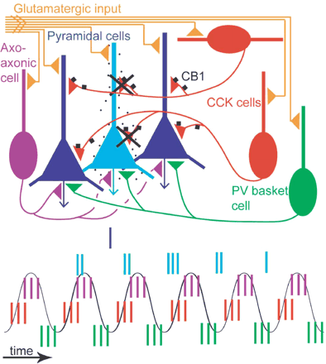
Primate Brains
Inhibitory Interneurons & Precision Control
Parvalbumin (PV) basket cells
Chandelier cells
Gating sequences
Notes:
Not all neural progress comes from adding more excitation.
Primates also evolved more diverse and powerful inhibitory neurons
— cells whose job is to precisely control when other neurons fire.
Inhibitory interneurons act like traffic lights and timing gates,
ensuring that signals flow in the right order and at the right moment.
In primates, certain interneuron types — especially parvalbumin (PV) basket cells and chandelier cells
— became more numerous and more tightly integrated into cortical circuits.
PV basket cells wrap around groups of pyramidal neurons and control their rhythm,
allowing coordinated bursts of activity.
Chandelier cells synapse directly onto the axon initial segment,
the place where neurons decide whether to spike,
giving them extraordinary power to open or close the gate on firing.
This enhanced inhibitory control allows circuitry to hold information stable
instead of letting it decay or become noisy.
It also enables sequencing, turning neural firing into structured steps rather than a blur of activation.
These systems help a primate brain keep a plan online, stop impulsive responses,
and wait for the right context before acting.
Importantly, inhibition also supports selective attention
— enhancing one internal stream while suppressing another.
Without strong inhibitory architecture, long-range loops discussed earlier would turn chaotic instead of structured.
So primate cognition depends not only on stronger signals, but on better brakes and timing systems that shape thought into organized sequences.

Slide 19
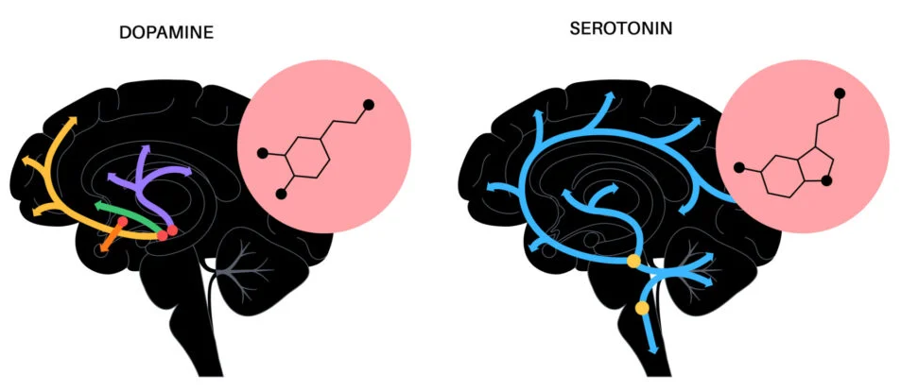
Primate Brains
Neuromodulators Shaped Social Cognition
Dopamine: value & future reward
Serotonin: patience & impulse control
Oxytocin: bonding & affiliation
Notes:
The evolution of primates saw significant adaptations in the neuromodulators oxytocin, dopamine, and serotonin.
The foundational roles of these chemicals were established earlier in vertebrate and mammalian history.
But their interplay and distribution within the expanding primate brain
became finely tuned to support the unique demands of complex social life.
These adaptations provided the neurochemical basis for the "social brain" hypothesis,
facilitating enhanced social cognition, emotional regulation,
and the navigation of intricate social hierarchies through distinct yet overlapping functions.
The dopamine system evolved to assign specific reward values to social interactions
and navigate complex dominance hierarchies.
In primates, dopamine signaling became a critical indicator of social status,
reinforcing dominant positions and the behaviors necessary to maintain them.
Beyond basic motor function, dopamine evolved to help primates evaluate the potential rewards of social choices
—weighing cooperation against competition
—and reinforced reciprocal altruism.
This system made social interaction inherently rewarding,
driving individuals to seek out and maintain complex social networks necessary
for survival and reproduction in a group setting.
Serotonin's evolution in primates focused on promoting social stability, impulse control, and managing social stress. In complex, hierarchical social groups, maintaining social order is paramount to survival. Higher serotonin function became associated with reduced impulsive aggression and increased behavioral flexibility, allowing individuals to conform to social rules and avoid costly conflicts. Serotonin systems help regulate mood and anxiety, providing a buffer against the stresses of social living and ensuring that individuals could learn from social outcomes and adapt their strategies within the group structure.
The co-evolution of these three neuromodulators was critical for the advanced social cognition of primates. The integration of oxytocin (trust, bonding), dopamine (reward, status), and serotonin (stability, impulse control) allowed primates to move beyond simple, hard-wired social behaviors. It provided the neurochemical underpinnings for empathy, alliance formation, the ability to interpret social cues, and complex social decision-making, ultimately catalyzing the development of the enhanced social cognitive capacities seen in humans.

Slide 20
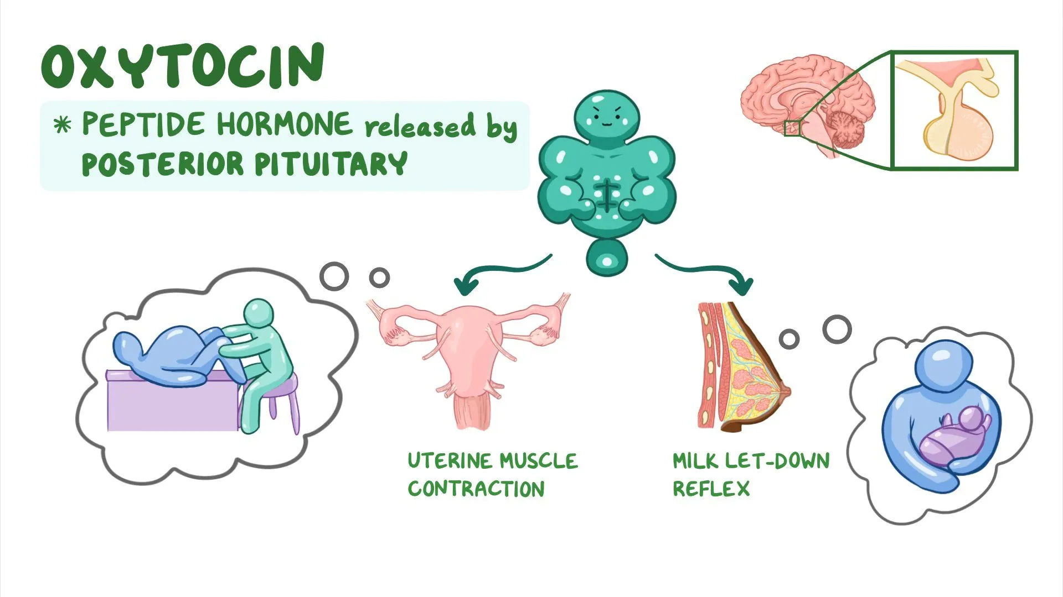
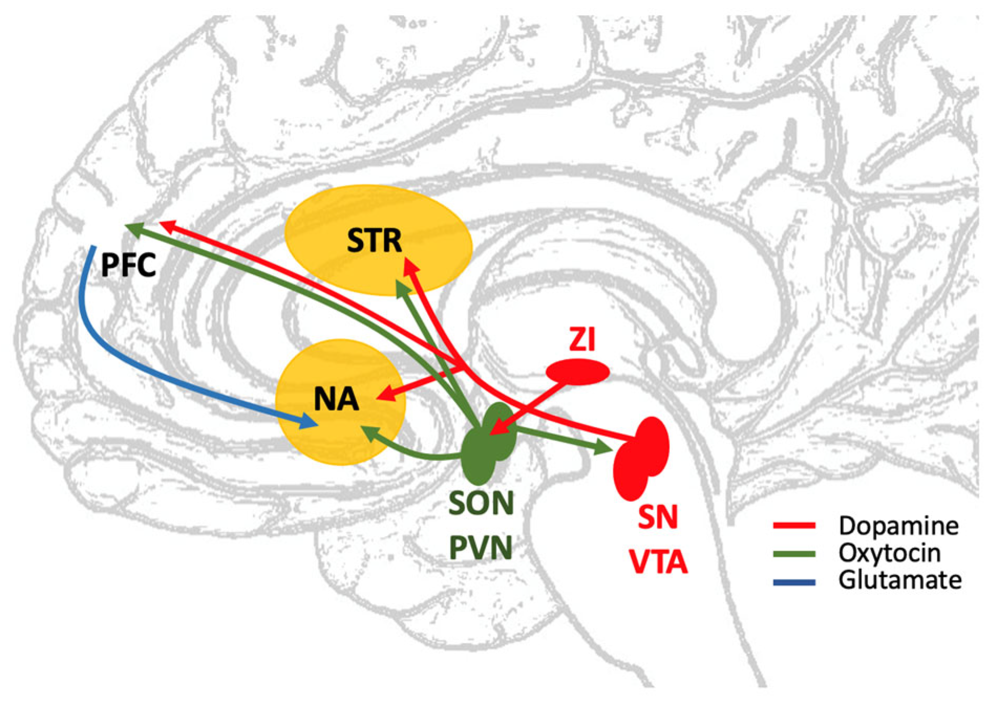
Primate Brains
Neuromodulators Shaped Social Cognition
Dopamine: value & future reward
Serotonin: patience & impulse control
Oxytocin: bonding & affiliation
Notes:
The evolutionary history of oxytocin's social effects on the brain began with ancient,
fundamental roles in reproduction and water balance across vertebrates.
While present in non-mammalian species like fish and birds,
where its analogs (isotocin, mesotocin) mediate simple courtship and parental behaviors,
a pivotal shift occurred in early mammalian evolution.
The oxytocin system was co-opted for crucial mammalian adaptations:
it became essential for the intensive mother-infant bond necessary for lactation and early survival.
This established the foundational use of the peptide in reinforcing close social relationships
and recognizing specific individuals, a general trait found in most mammals.
The transition from basic maternal recognition to complex social cognition
was driven by the evolution of specific neural circuits,
particularly the interaction between oxytocin and the dopamine reward system.
This allowed certain mammals, including many primates and a few monogamous rodent species,
to form enduring, selective social bonds beyond the mother-infant relationship.
In the primate lineage, this system became increasingly sophisticated,
facilitating complex behaviors like empathy, trust, and advanced social memory
by modulating attention to social cues and dampening fear responses.
Ultimately, oxytocin evolved to function as a powerful neuromodulator,
fine-tuning the balance of threat and reward perception
to enable the intricate social structures and cognitive abilities essential for human social life.
The synergistic interaction between all three systems
ultimately drove the evolution of advanced social cognition.
Oxytocin, dopamine, and serotonin pathways became increasingly intertwined
in key limbic and cortical regions of the primate brain.
Oxytocin, for instance, has been shown to induce the release of serotonin and influence dopamine signaling,
creating a positive feedback loop that prioritizes and reinforces social engagement.
This integrated neurochemical network provided the necessary biological substrate
for the development of empathy, theory of mind,
and the capacity for complex cultural and linguistic behavior that reached its peak in humans.

Slide 21
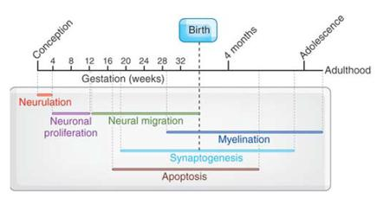
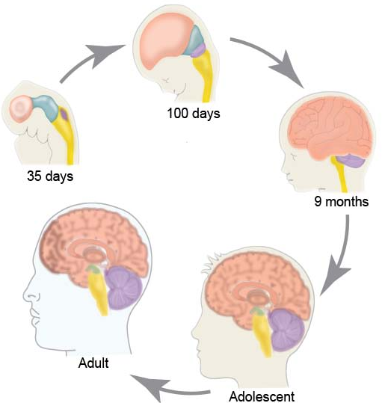
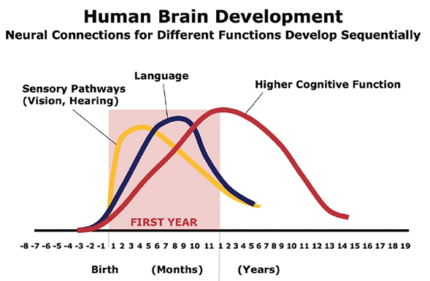
Primate Brains
Development Built the Social Brain
Long childhood
Extended plasticity
Experience-dependent tuning
Notes:
Primate brains did not just change in structure — they changed in how long they took to build.
Compared to other mammals, primates spent far more time in a dependent juvenile phase.
This extended development provided a long window in which experience could shape social circuits.
A prolonged childhood meant more chances to observe alliances form and dissolve,
to practice negotiation and play-fighting, and to learn whom to trust.
For humans this period is even longer, allowing culture, norms,
and language to be layered onto the basic primate template.
During this extended window, synaptic pruning, myelination,
and strengthening of long-range connections proceeded gradually.
Circuits that were frequently used in social contexts were reinforced,
while others were trimmed away
— a biological way of installing the strategies that actually worked in a given group.
This developmental schedule was costly, requiring extended parental care and group protection.
But it allowed primates — and especially humans
— to calibrate their minds to their social world, not just inherit a fixed pattern from evolution.

Slide 22
Primate Brains
White Matter Tracts for Story-Holding Minds
Front–temporal highways
Integrating memory + value + plans
Keeping others “in mind”
Notes:
To support long-range reasoning about relationships and futures,
primate brains relied on major white-matter tracts
linking frontal regions to memory and perceptual hubs.
These fiber pathways acted like private highways, letting plans, memories, emotions,
and social knowledge circulate rapidly across the cortex.
They enabled the brain to hold a “story” of relationships over time — not just react to the moment.
Key tracts grew in size and importance, such as the uncinate fasciculus
connecting orbitofrontal cortex to the temporal pole and amygdala,
and the cingulum bundle linking medial prefrontal regions
to hippocampal and posterior medial areas.
These pathways integrated value signals, autobiographical memory, and social knowledge,
supporting the ability to remember who did what, what it meant,
and how it should shape the next decision.
In humans, these networks expanded further, allowing working models of others
to stretch across hours, days, and even years.
The result was a brain capable of maintaining rich narratives about relationships, obligations, and reputations
— the raw material of complex social life.
White-matter growth was resource-intensive, requiring extra time, energy, and coordinated development
— but it allowed minds to become networks that could sustain social stories,
not just single acts or impressions.

Slide 23
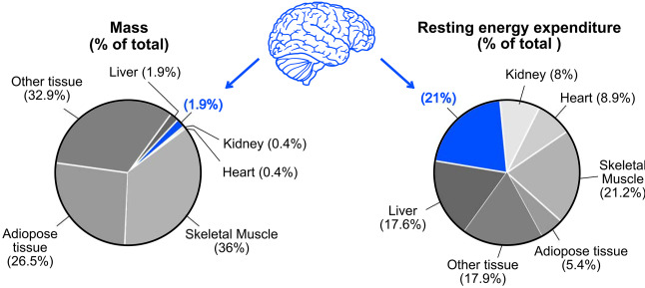
Primate Brains
Energy Budget & Evolutionary Trade-offs
Big brains = big costs
Slow life histories
Social strategy paid for it
Notes:
Large primate brains were expensive.
They consumed more calories at rest, required more time to grow,
and demanded extended parental investment to protect slow-maturing offspring.
Compared to many mammals, primates reproduced later, had fewer young, and invested heavily in each one
— a costly strategy in evolutionary terms.
This “expensive tissue” shift meant trade-offs elsewhere in biology.
Primate guts shrank relative to body size, diets shifted toward high-quality foods,
and group care systems helped buffer the long juvenile stage.
Brains did not expand in isolation — bodies and social systems reorganized around supporting them.
Because development was slow and mistakes were costly,
evolution favored individuals who made better long-term decisions:
choosing allies wisely, managing relationships, navigating competition,
and securing future support.
The metabolic investment only made sense if smarter social behavior
generated enough benefit to pay the biological bill.
In other words, primates did not get large brains “for free.”
They evolved them because navigating a social world
— predicting others, planning ahead, learning from observation
— yielded enough advantage to outweigh the steep energetic and life-history costs.

Slide 24
Primate Brains
Summary
Social cognition across Marr’s levels
Today: neural architecture for social minds
Next Time
Human brain evolution — language → symbolic thought
Notes:
This week we explored social cognition from evolutionary pressures and behavioral evidence,
through computational principles, and today into the neural machinery that makes it possible.
We walked through how primate brains restructured themselves to support modeling others,
anticipating future states, learning from observation, and sustaining long-range social plans.
Instead of simple reactive circuits, we saw distributed networks,
dense long-range connectivity, expanded association cortex,
and microcircuit changes that enabled flexible thought and extended memory.
The picture that emerged was a nervous system designed not just to sense and respond,
but to predict, remember, simulate, and coordinate in a complex social world.
Primates didn’t just act socially — they built internal architectures capable of holding social information over time,
evaluating future consequences, and integrating experience from many partners and contexts.
Today’s material showed how those capacities were implemented
in cortex, white-matter pathways, neuromodulatory systems, and developmental patterns.
Next, we turn to the story of the human brain.
Primates gave evolution a powerful toolkit
— predictive social learning, working memory for intentions, flexible planning
— and humans layered new systems on top.
Next week we’ll trace how the human brain diverged from the primate template to support language,
a tool that amplified social reasoning and shared modeling.
The following week, we’ll examine how language scaffolded symbolic and abstract cognition,
enabling the uniquely cumulative and conceptual culture seen in our species.
Together, these next two modules will connect today’s neural story
to the emergence of communication, shared meaning, and complex thought
— and how those built the cognitive world we live in.

